Slide 1
BMD ENG 301 Quantitative Systems Physiology (Nervous System)
Lecture 4: Glial Cells
2022_v1
Professor Malcolm A. MacIver

Slide 2
Quote of the day
The best time to plant a tree is 20 years ago
The second best time is right now
Chinese Proverb

Slide 3
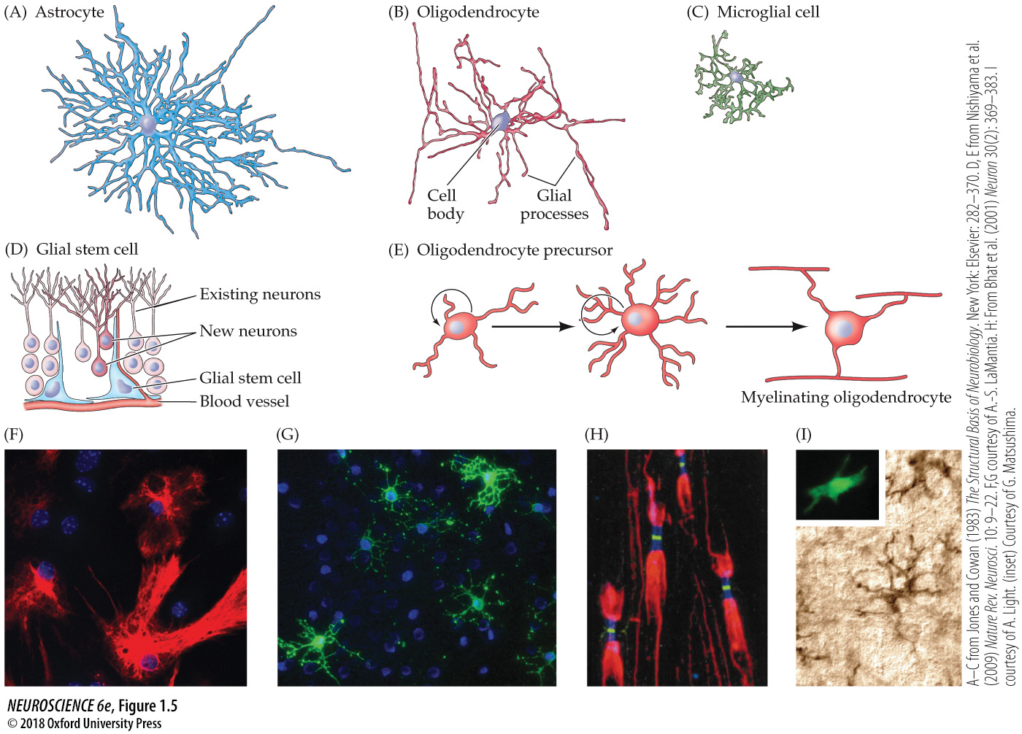
Notes:
FIGURE 1.5 Glial cell types. (A–C) Tracings of differentiated glial cells in the mature nervous system visualized using the Golgi method include an astrocyte (A), an oligodendrocyte (B), and a microglial cell (C). The three tracings are at approximately the same scale. (D) Glial stem cells in the mature nervous system include stem cells with properties of astrocytes that can give rise to neurons, astrocytes, and oligodendrocytes. (E) Another class of glial stem cell, the oligodendrocyte precursor, has a more restricted potential, giving rise primarily to differentiated oligodendrocytes. (F) Astrocytes (red) in tissue culture are labeled with an antibody against an astrocyte-specific protein. (G) Oligodendrocytes (green) in tissue culture labeled with an antibody against an oligodendrocyte-specific protein. (H) Peripheral axons are ensheathed by myelin (labeled red) except at nodes of Ranvier (see Figure 1.3G). The green label indicates ion channels (see Chapter 4) concentrated in the node; the blue label indicates a molecularly distinct region called the paranode. (I) Microglial cells from the spinal cord labeled with a cell type–specific antibody. Inset: Higher-magnification image of a single microglial cell labeled with a macrophage-selective marker. (A–C after Jones and Cowan, 1983; D,E, after Nishiyama et al., 2009; F,G courtesy of A.-S. LaMantia; H from Bhat et al., 2001; I courtesy of A. Light, inset courtesy of G. Matsushima.)

Slide 4
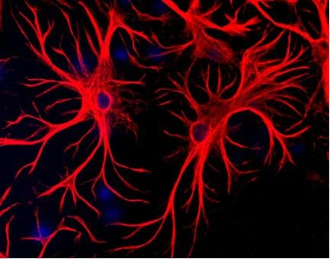

Slide 5
Notes:
FIGURE 1.5 Glial cell types. (A–C) Tracings of differentiated glial cells in the mature nervous system visualized using the Golgi method include an astrocyte (A), an oligodendrocyte (B), and a microglial cell (C). The three tracings are at approximately the same scale. (D) Glial stem cells in the mature nervous system include stem cells with properties of astrocytes that can give rise to neurons, astrocytes, and oligodendrocytes. (E) Another class of glial stem cell, the oligodendrocyte precursor, has a more restricted potential, giving rise primarily to differentiated oligodendrocytes. (F) Astrocytes (red) in tissue culture are labeled with an antibody against an astrocyte-specific protein. (G) Oligodendrocytes (green) in tissue culture labeled with an antibody against an oligodendrocyte-specific protein. (H) Peripheral axons are ensheathed by myelin (labeled red) except at nodes of Ranvier (see Figure 1.3G). The green label indicates ion channels (see Chapter 4) concentrated in the node; the blue label indicates a molecularly distinct region called the paranode. (I) Microglial cells from the spinal cord labeled with a cell type–specific antibody. Inset: Higher-magnification image of a single microglial cell labeled with a macrophage-selective marker. (A–C after Jones and Cowan, 1983; D,E, after Nishiyama et al., 2009; F,G courtesy of A.-S. LaMantia; H from Bhat et al., 2001; I courtesy of A. Light, inset courtesy of G. Matsushima.)

Slide 6
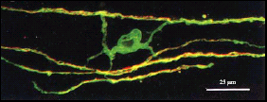

Slide 7
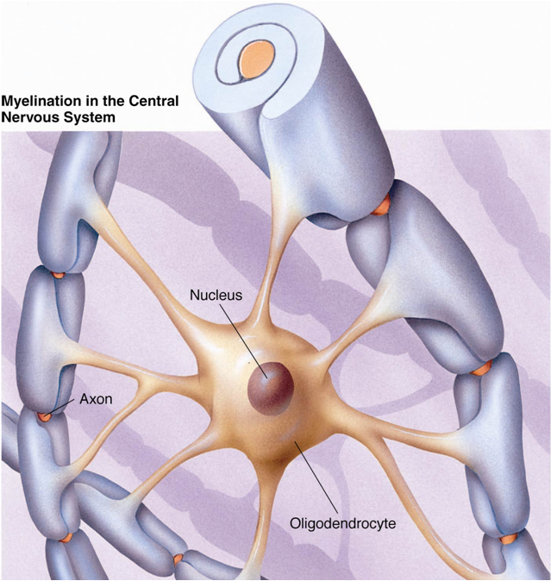

Slide 8
Notes:
FIGURE 1.5 Glial cell types. (A–C) Tracings of differentiated glial cells in the mature nervous system visualized using the Golgi method include an astrocyte (A), an oligodendrocyte (B), and a microglial cell (C). The three tracings are at approximately the same scale. (D) Glial stem cells in the mature nervous system include stem cells with properties of astrocytes that can give rise to neurons, astrocytes, and oligodendrocytes. (E) Another class of glial stem cell, the oligodendrocyte precursor, has a more restricted potential, giving rise primarily to differentiated oligodendrocytes. (F) Astrocytes (red) in tissue culture are labeled with an antibody against an astrocyte-specific protein. (G) Oligodendrocytes (green) in tissue culture labeled with an antibody against an oligodendrocyte-specific protein. (H) Peripheral axons are ensheathed by myelin (labeled red) except at nodes of Ranvier (see Figure 1.3G). The green label indicates ion channels (see Chapter 4) concentrated in the node; the blue label indicates a molecularly distinct region called the paranode. (I) Microglial cells from the spinal cord labeled with a cell type–specific antibody. Inset: Higher-magnification image of a single microglial cell labeled with a macrophage-selective marker. (A–C after Jones and Cowan, 1983; D,E, after Nishiyama et al., 2009; F,G courtesy of A.-S. LaMantia; H from Bhat et al., 2001; I courtesy of A. Light, inset courtesy of G. Matsushima.)

Slide 9

Microglia
CNS emergency response team

Slide 10

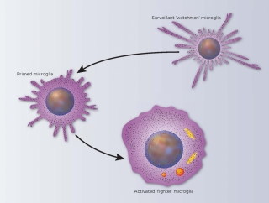



Microglial Cell
Cleaning To Do List
Remove injured cells
Fight infections
Eliminate memories

Slide 11
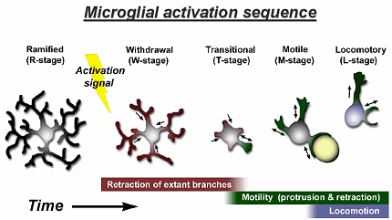

Slide 12
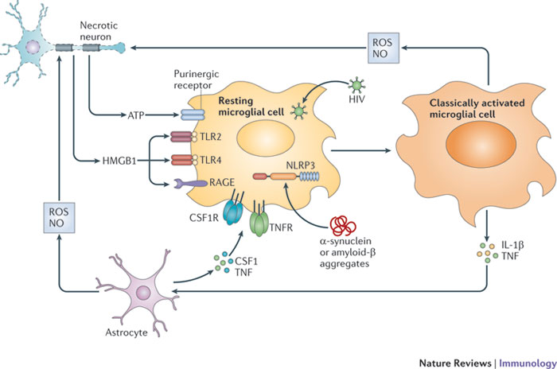

Slide 13
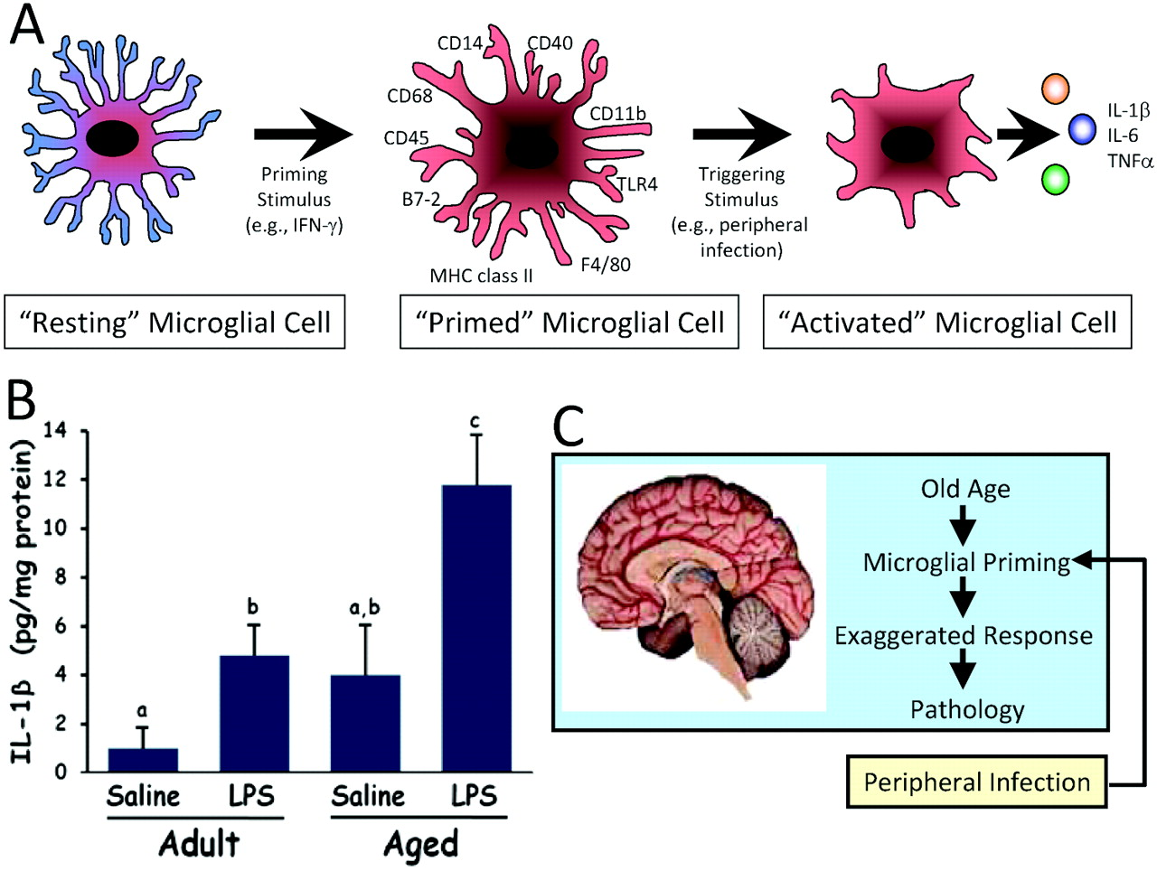

Slide 14
Notes:
FIGURE 1.5 Glial cell types. (A–C) Tracings of differentiated glial cells in the mature nervous system visualized using the Golgi method include an astrocyte (A), an oligodendrocyte (B), and a microglial cell (C). The three tracings are at approximately the same scale. (D) Glial stem cells in the mature nervous system include stem cells with properties of astrocytes that can give rise to neurons, astrocytes, and oligodendrocytes. (E) Another class of glial stem cell, the oligodendrocyte precursor, has a more restricted potential, giving rise primarily to differentiated oligodendrocytes. (F) Astrocytes (red) in tissue culture are labeled with an antibody against an astrocyte-specific protein. (G) Oligodendrocytes (green) in tissue culture labeled with an antibody against an oligodendrocyte-specific protein. (H) Peripheral axons are ensheathed by myelin (labeled red) except at nodes of Ranvier (see Figure 1.3G). The green label indicates ion channels (see Chapter 4) concentrated in the node; the blue label indicates a molecularly distinct region called the paranode. (I) Microglial cells from the spinal cord labeled with a cell type–specific antibody. Inset: Higher-magnification image of a single microglial cell labeled with a macrophage-selective marker. (A–C after Jones and Cowan, 1983; D,E, after Nishiyama et al., 2009; F,G courtesy of A.-S. LaMantia; H from Bhat et al., 2001; I courtesy of A. Light, inset courtesy of G. Matsushima.)

Slide 15

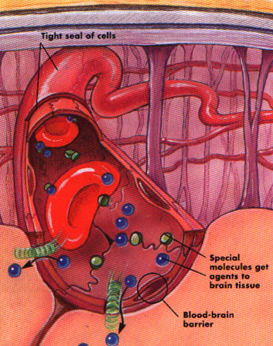

Blood-brain barrier

Slide 16
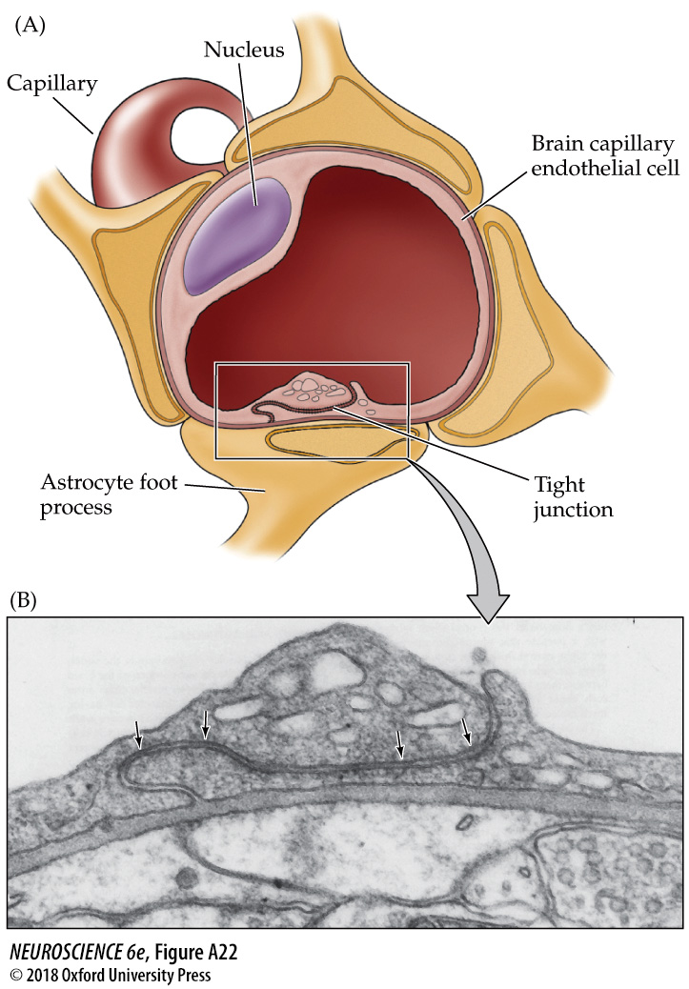
Notes:
FIGURE A22 Cellular basis of the blood–brain barrier. (A) Diagram of a brain capillary in cross section and reconstructed views, showing endothelial tight junctions and the investment of the capillary by astrocytic end feet. (B) Electron micrograph of boxed area in (A), showing the appearance of tight junctions between neighboring endothelial cells (arrows). (A after Goldstein and Betz, 1986; B from Peters et al., 1991.)

Slide 17
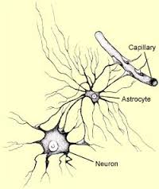

Slide 18
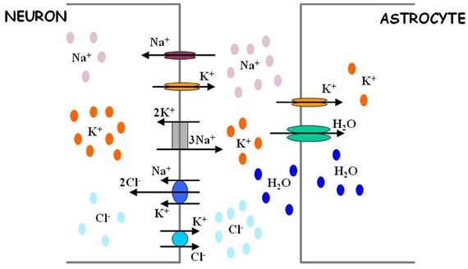

Slide 19
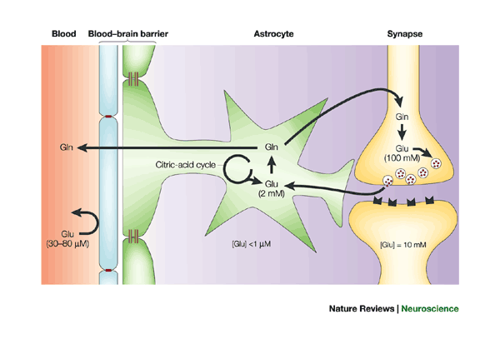

Slide 20
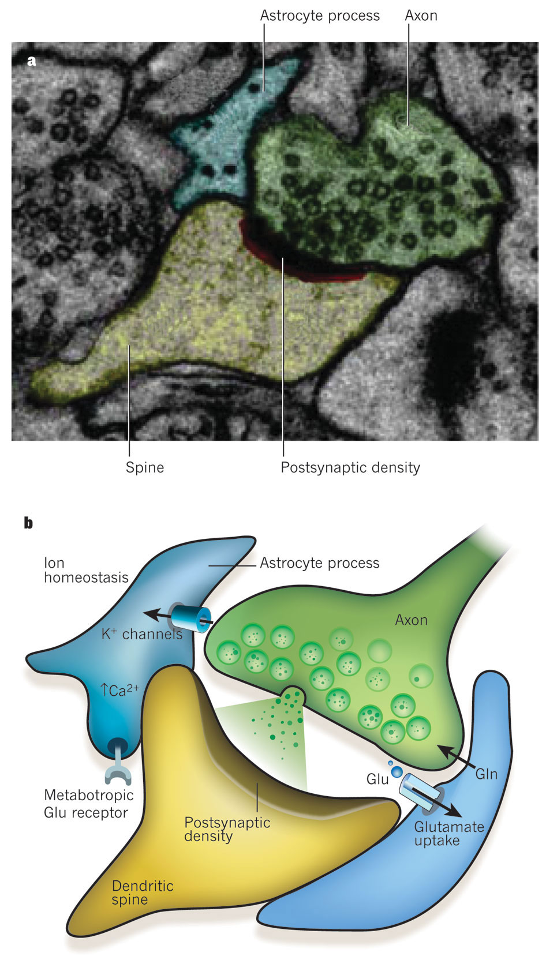
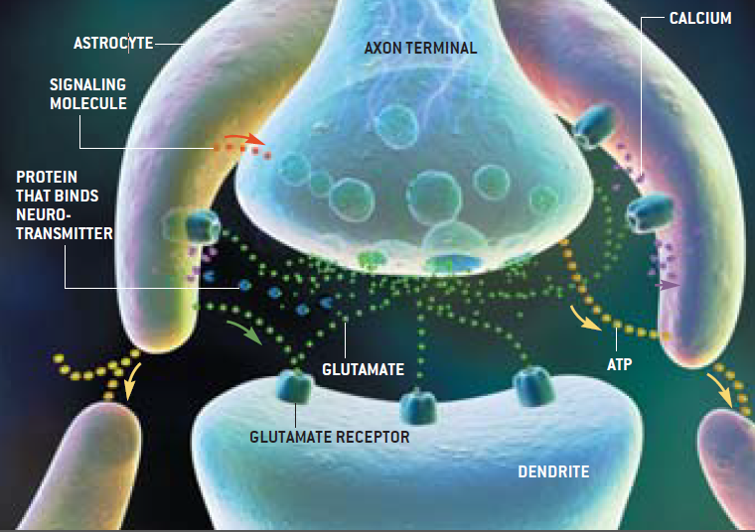

Slide 21
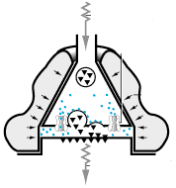
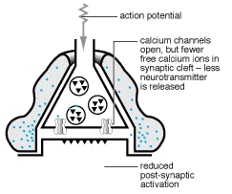
Ca²⁺ and Synaptic Efficacy

Slide 22
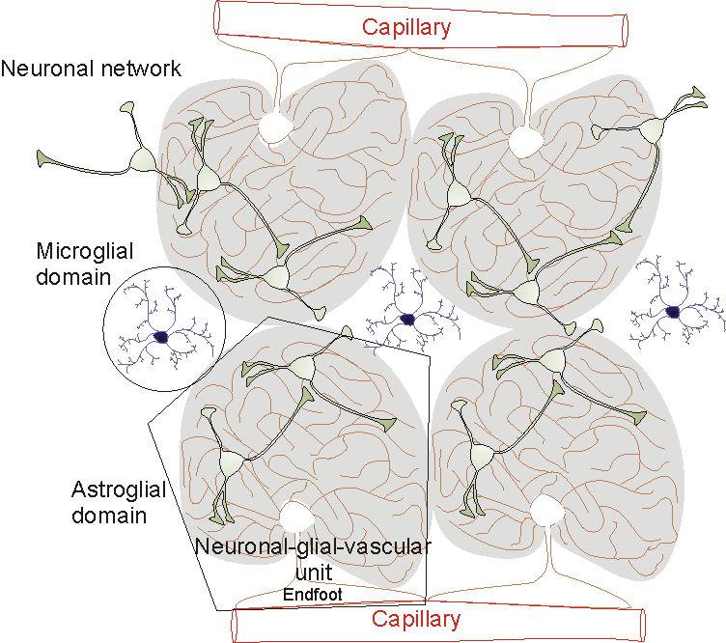

Slide 23
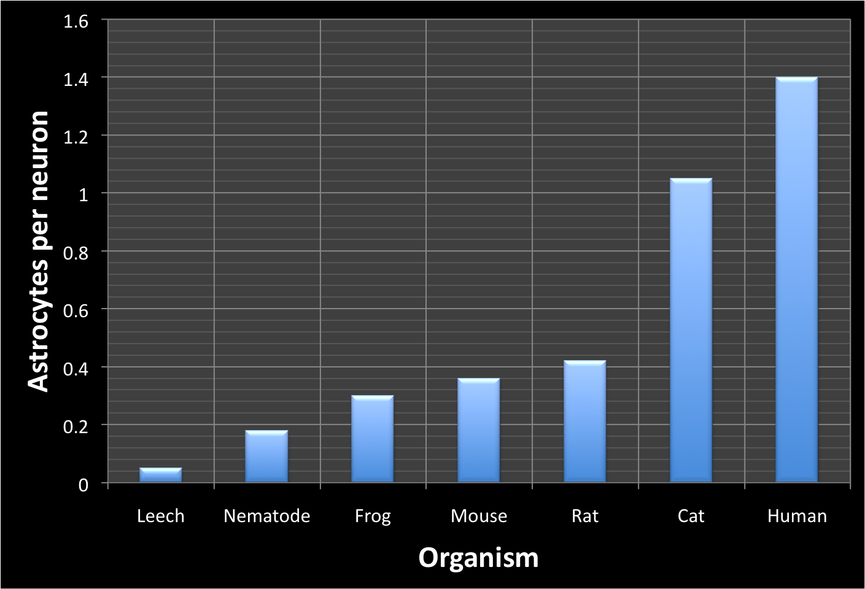

Slide 24
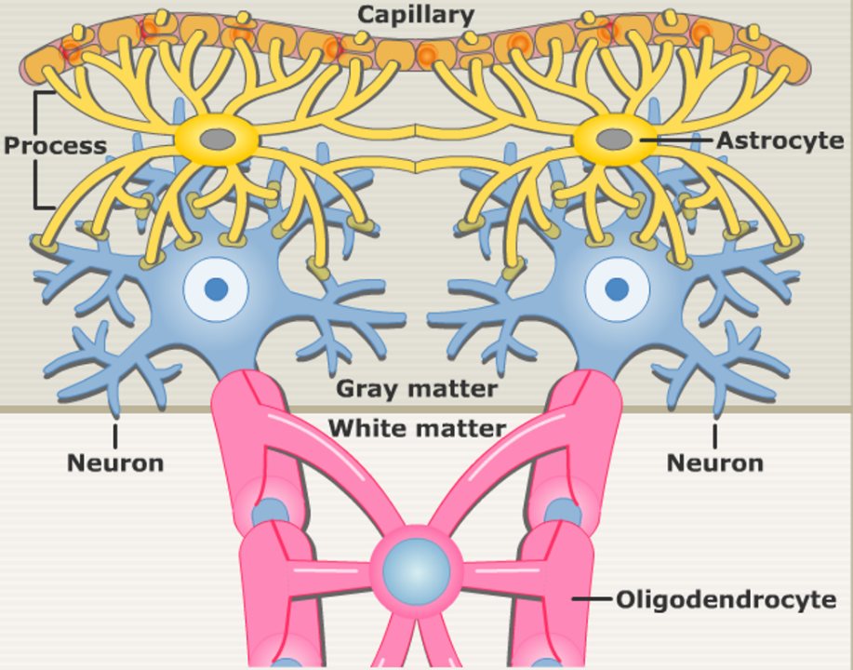
Astrocytes and Oligondendrocytes are in the Service of Neurons

Slide 25
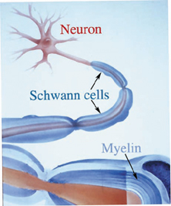
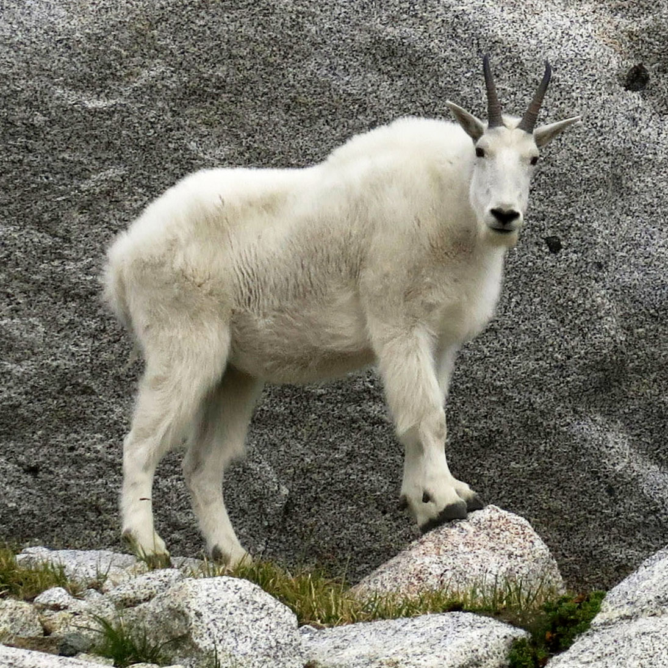

Slide 26
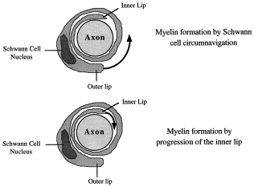
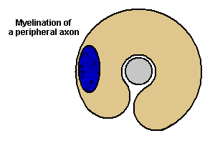
Myelinating Schwann cells

Slide 27
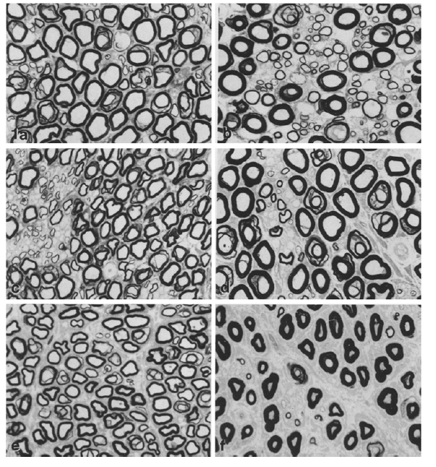

Slide 28
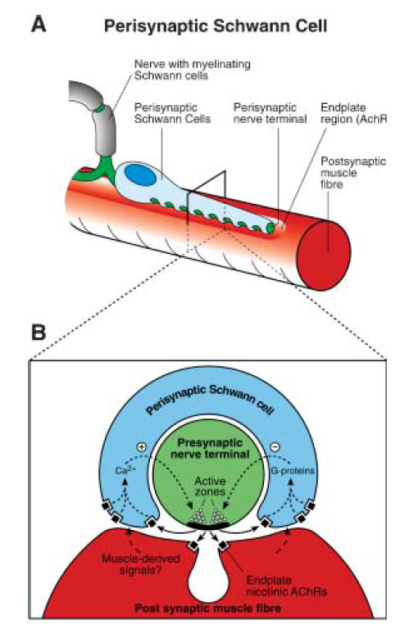
Terminal (Perisynaptic) Schwann cells
Non-Myelinating Schwann Cells at Neuromuscular Junctions
Axonal renervation of denervated endplates
Enhance or decrease neurotransmission at NMJs

Slide 29
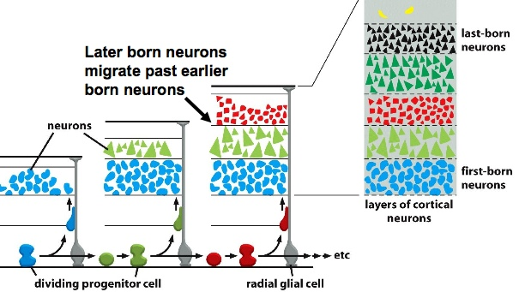

Slide 30
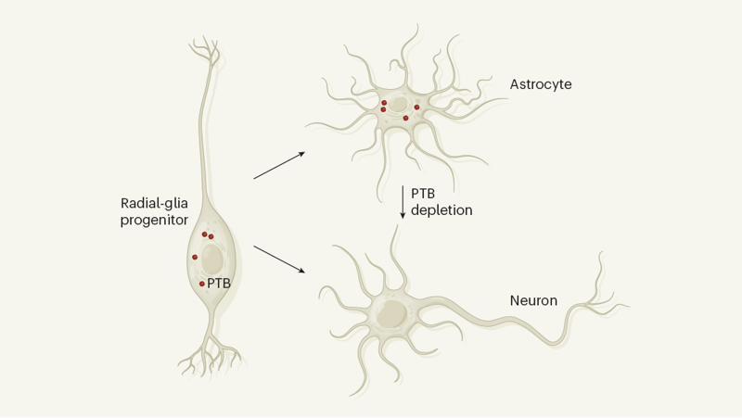

Slide 31
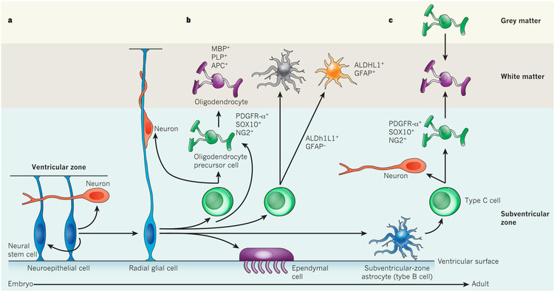

Slide 32
Notes:
FIGURE 1.5 Glial cell types. (A–C) Tracings of differentiated glial cells in the mature nervous system visualized using the Golgi method include an astrocyte (A), an oligodendrocyte (B), and a microglial cell (C). The three tracings are at approximately the same scale. (D) Glial stem cells in the mature nervous system include stem cells with properties of astrocytes that can give rise to neurons, astrocytes, and oligodendrocytes. (E) Another class of glial stem cell, the oligodendrocyte precursor, has a more restricted potential, giving rise primarily to differentiated oligodendrocytes. (F) Astrocytes (red) in tissue culture are labeled with an antibody against an astrocyte-specific protein. (G) Oligodendrocytes (green) in tissue culture labeled with an antibody against an oligodendrocyte-specific protein. (H) Peripheral axons are ensheathed by myelin (labeled red) except at nodes of Ranvier (see Figure 1.3G). The green label indicates ion channels (see Chapter 4) concentrated in the node; the blue label indicates a molecularly distinct region called the paranode. (I) Microglial cells from the spinal cord labeled with a cell type–specific antibody. Inset: Higher-magnification image of a single microglial cell labeled with a macrophage-selective marker. (A–C after Jones and Cowan, 1983; D,E, after Nishiyama et al., 2009; F,G courtesy of A.-S. LaMantia; H from Bhat et al., 2001; I courtesy of A. Light, inset courtesy of G. Matsushima.)

